Slide 1
Organometallic Precursors for the Deposition of Inorganic Materials
Lisa McElwee-White
Department of Chemistry
University of Florida

Slide 2
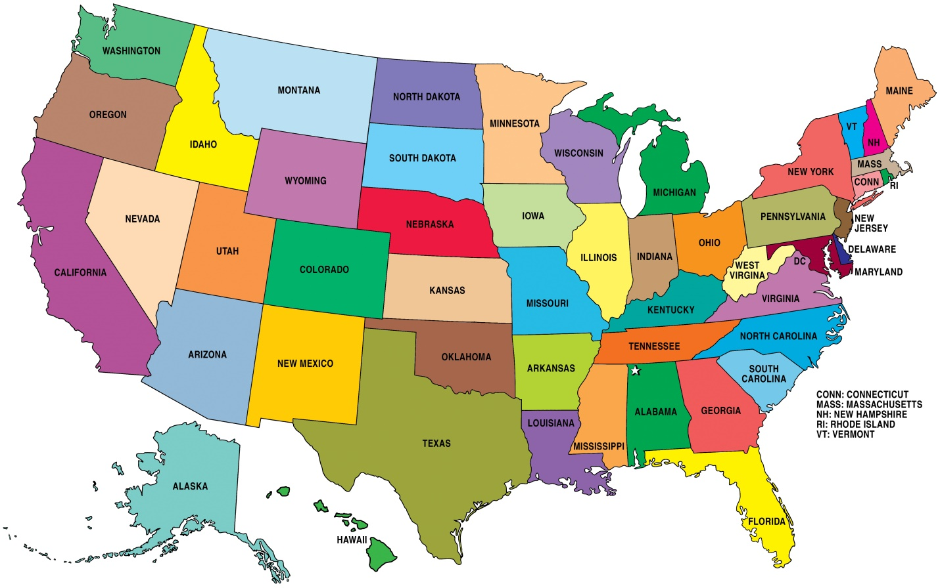
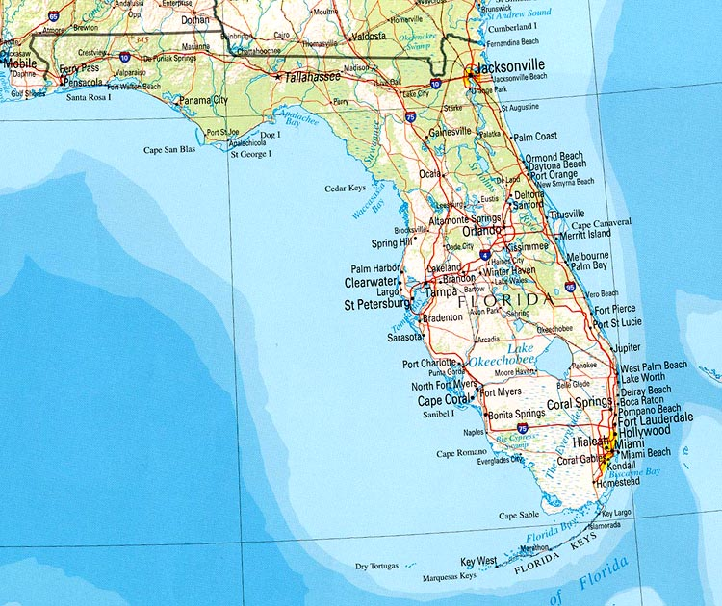
Where we are…
University of Florida
(Site for student secondments)

Slide 3
What Do We Do?
We are organometallic chemists.
We synthesize new complexes, elucidate reaction mechanisms, perform electronic structure calculations, determine structure-reactivity relationships, etc.
We design precursors for deposition of materials….
….tailored for several different techniques
We do interdisciplinary work with lots of collaborators in chemistry, chemical engineering, materials science, electrical engineering, etc.

Slide 4
Projects
Design and synthesis of precursors for:
EBID of metal nanostructures
CVD of metal nitride films as diffusion barriers for integrated circuits
CVD of metal oxide films as hole injection layers for OLEDs
Photoassisted CVD for metallization on thermally sensitive organic electronics
Surface plasmon mediated deposition of nanostructures

Slide 5
EBID of metal nanostructures
Collaborative work with Howard Fairbrother (Johns Hopkins Chemistry)
Oddur Ingólfsson (University of Iceland)
and Ivo Utke (EMPA)

Slide 6
Precursor Development: cis-Pt(CO)₂Cl₂
Synthesis
Belli Dell’ Amico et al, J. Chem. Soc., Dalton Trans., 1996, 4317.
Characterization
Properties
White/light yellow needles
Extreme sensitivity to moisture
Stable under CO in the freezer for months
Sublimes under vacuum
IR: ν_{CO} 2127, 2171 cm⁻¹
¹³C NMR: δ 151.84

Slide 7















Screening by UHV Surface Science
Typical EBID Experiment
UHV Surface Science Approach
Gas Injection System
Electron
Source
~10⁻⁵ Torr
X-ray
Source
MS
Electron
Source
< 10⁻⁸ Torr
Energy
Analyzer
e⁻
hν
e⁻
e⁻
e⁻
e⁻
e⁻
Substrate (~295 K)
Substrate ( < 200 K)
Graphic (and Experiments): Howard Fairbrother
Constant partial pressure of precursor
Substrate at room temperature
Focused electron beam (20 – 200 KeV)
Size scale: ~ nm³
Analytical techniques: SEM, EDX
Information obtained: composition and
dimensions of deposited structure
Fixed initial coverage of precursor molecules
Substrate cooled to < 200K
Defocused low energy electron beam (0.5 KeV)
Size scale: ~ cm²
Analytical techniques: XPS, MS
Information obtained: kinetic and mechanistic
details of precursor decomposition

Slide 8
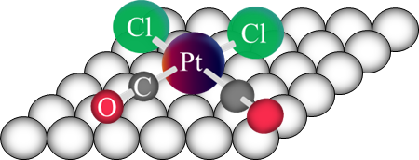
Screening by UHV Surface Science: cis-PtCl₂(CO)₂
e⁻
Spencer, Wu, McElwee-White, Fairbrother, J. Am. Chem. Soc., 2016, 138, 9172.

Slide 9
CVD of metal nitride films as diffusion barriers for integrated circuits
Collaborative work with Tim Anderson (UF/UMass Chemical Engineering)
CVD of metal oxide films as hole injection layers for Organic Light Emitting Diodes (OLEDs)
Collaborative work with Tim Anderson (UF/UMass Chemical Engineering)
and Roman Korotkov (Arkema, Inc)

Slide 10
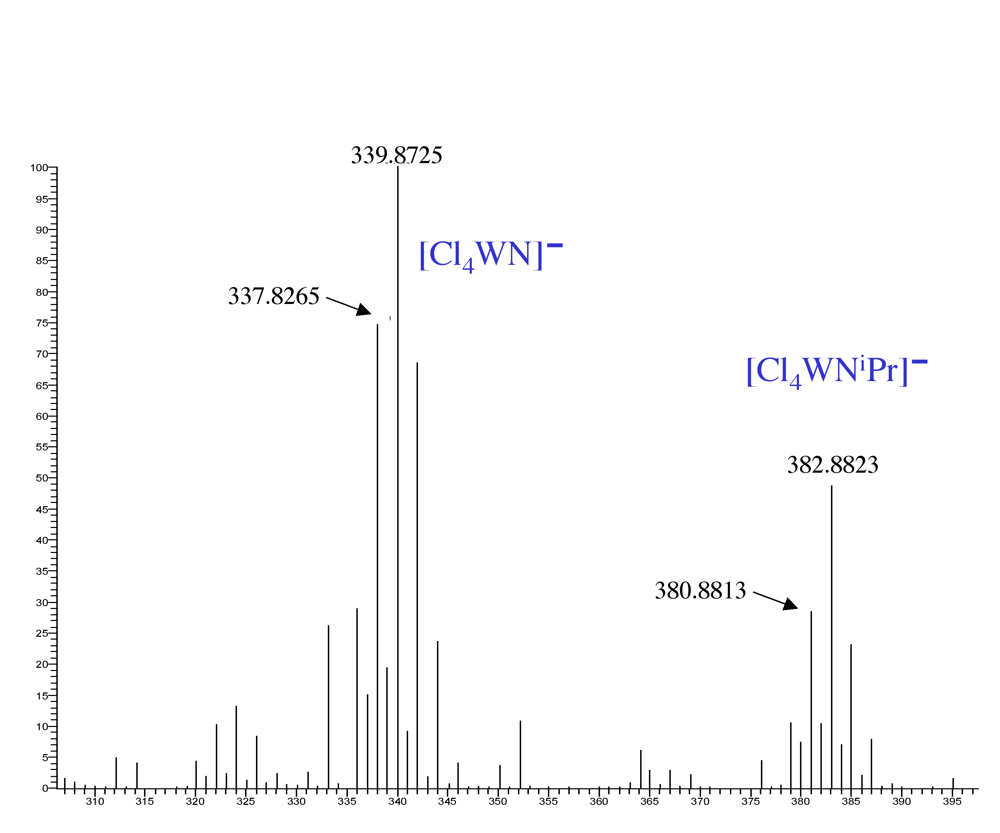
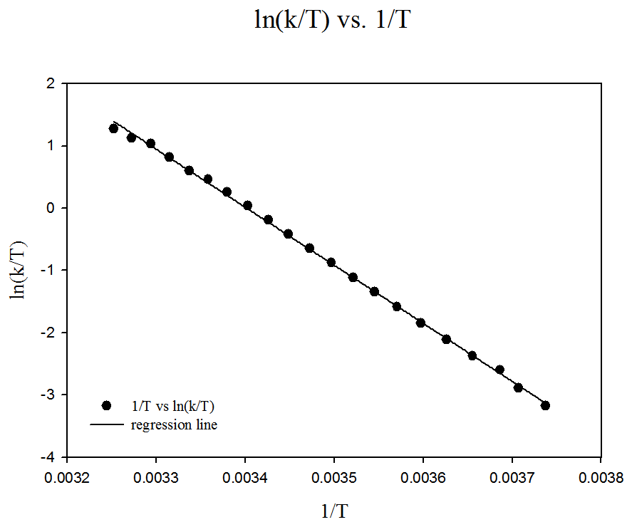
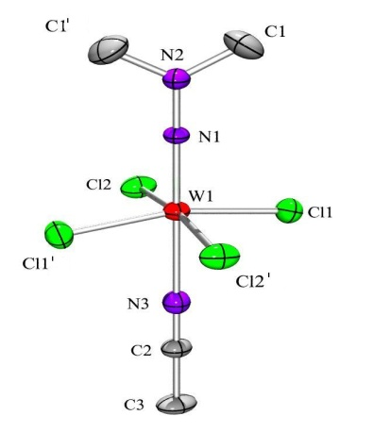
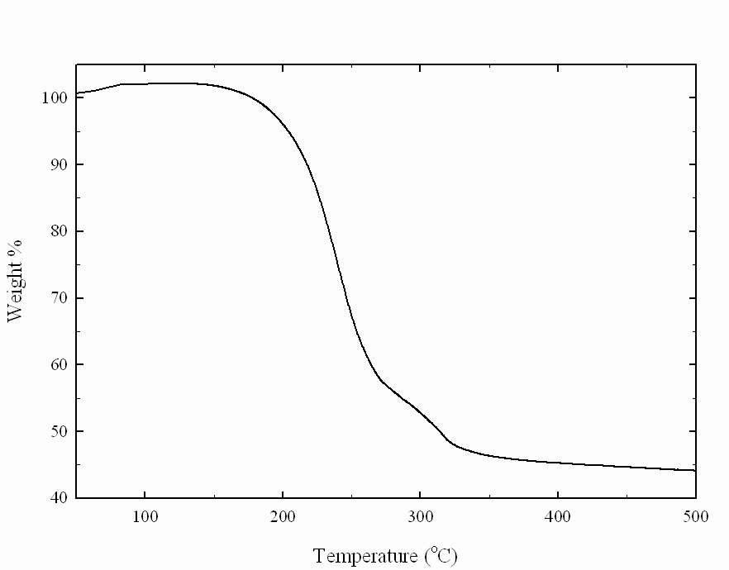
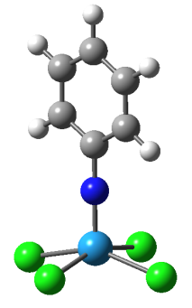
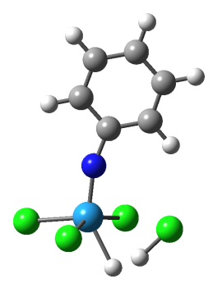
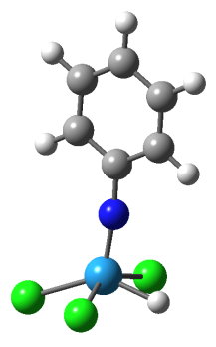
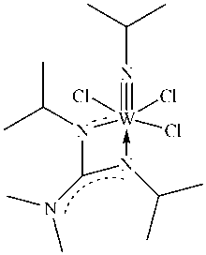
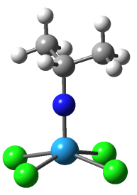
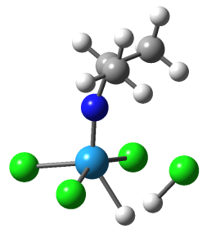
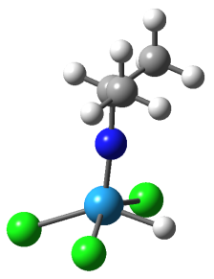
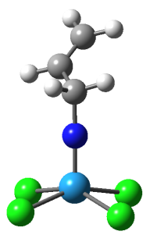
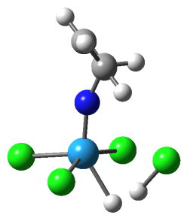
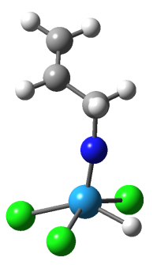
Screening of CVD Precursors
by NMR kinetics
by mass spectrometry
by X-ray crystallography
by thermogravimetric analysis
by DFT calculations
+ H₂
- HCl
36.1
kcal/mol
-23.4
1a
TS-1
+ H₂
- HCl
37.1
-23.8
2a
MI-1
TS-2
+ H₂
- HCl
36.3
-23.3
3a
TS-3

Slide 11
Photoassisted CVD for metallization on organic electronics
Collaborative work with Amy Walker (UT Dallas)

Slide 12
Precursor Development: CpRu(CO)₂Me
Desired precursor characteristics for deposition on patterned SAMs:
Volatile
High quantum yields for ligand loss
Potential for ligands to react with protic surface
                Sublimes at 50 °C at 1 atm
                Φ = 0.4 for loss of CO
                Methyl could react with –COOH or –OH terminated SAMs
Johnson, Arevalo Rodriguez, Brewer, Brannaka, Shi, Yang, Salazar, McElwee-White, Walker, J. Chem. Phys., under revision.

Slide 13
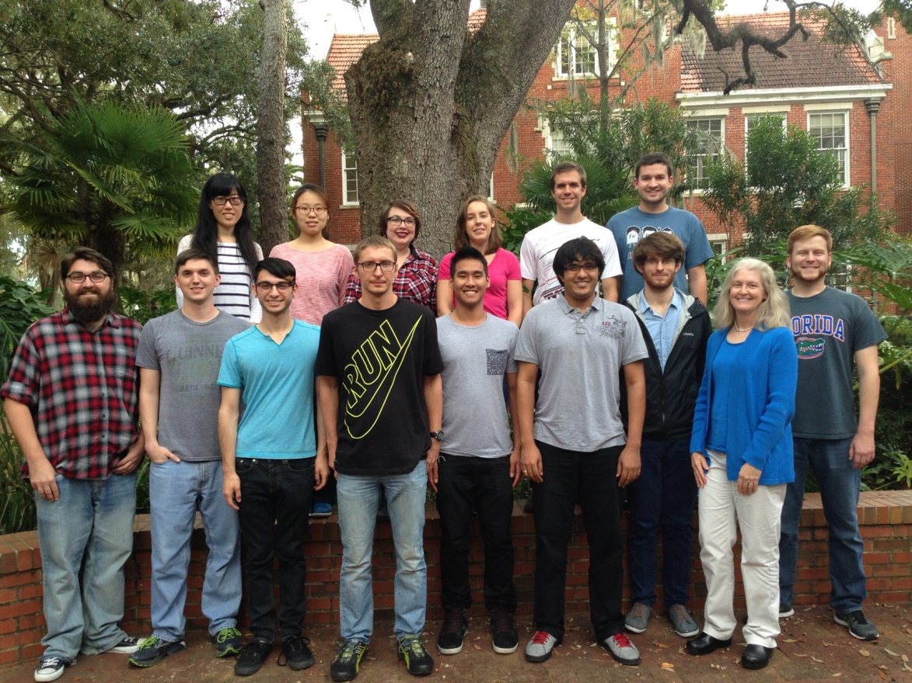




Current Research Group
11 PhD students
5 undergraduates

